Slide 1
CYBER SECURITY
Submitted by :- Anhad Arshnoor Singh
CRN :- 2221144

Slide 2
What is Cyber Security all about ?
Cybersecurity is the practice of protecting systems, networks, and programs from digital attacks. These cyberattacks are usually aimed at accessing, changing, or destroying sensitive information; extorting money from users; or interrupting normal business processes.
Implementing effective cybersecurity measures is particularly challenging today because there are more devices than people, and attackers are becoming more innovative

Slide 3

Hacking
In simple words, The gaining of unauthorized access to data in a system or computer is called as hacking.
Hacking is not always a malicious act, but it is most commonly associated with illegal activity and data theft by cyber criminals.

Slide 4
Types of Hacking
Ethical Hacking
Unethical Hacking
Ethical behavior follows the majority of social norms and such actions are acceptable to the public
Attempting to evade intrusion detection systems :-
honeypots
firewalls
Unethical behavior can be defined as actions that are against social norms or acts that are considered unacceptable to the public
It includes Internet searches being directed to other unrelated sites.
Antivirus Software getting disabled on its own.
Speed of a computer slowing down to a crawl.

Slide 5
Types of Hackers
Black Hat
White Hat Hackers
Grey Hat Hackers
Script.
Hacktivist

Slide 6
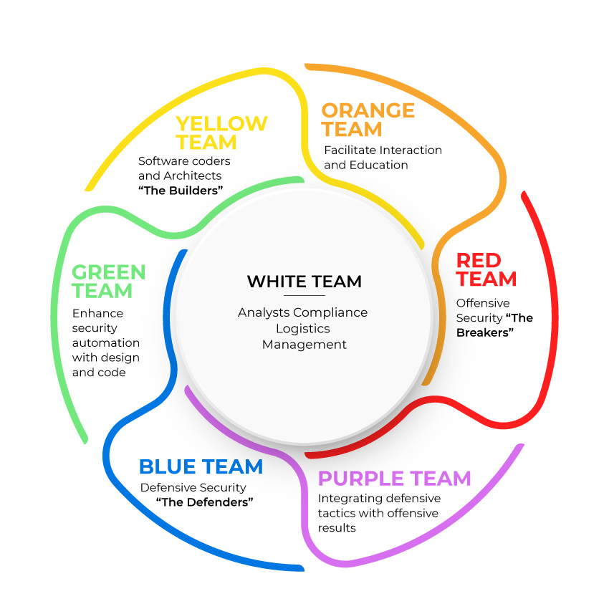
TEAMS

Slide 7

Cyber Security totally relies upon data security.
CYBER SECURITY
DATA SECURITY

Slide 8

DATA SECURITY
Data is a valuable asset , protecting it from internal or external corruption and illegal access protects a company from financial loss, reputational harm, consumer trust degradation, and brand erosion.
Data security refers to protecting your data against unauthorized access or use that could result in exposure, deletion, or corruption of that data

Slide 9
Data Security consist of 3 things
DATA SECURITY
PRIVACY
CONIDENTIAL
INTEGRITY
Modifying only by authorised user
Not for public
Data should be secret

Slide 10

Data Security Application
CRYPTOGRAPHY - Cryptography refers to secure information and communication techniques derived from mathematical concepts and a set of rule-based calculations called algorithms, to transform messages in ways that are hard to decipher.

Slide 11

CRYPTOGRAPHY
It is technique of securing information and communications through use of codes so that only those person for whom the information is intended can understand it and process it. Thus preventing unauthorized access to information. The prefix “crypt” means “hidden” and suffix graphy means “writing”.
Cryptography can ensure the confidentiality and integrity of both data in transit as well as data at rest.

Slide 12

Cryptography consist of 2 steps :-
ENCRYPTION -- Encryption is the method by which information is converted into secret code that hides the information's true meaning. In this PLAIN TEXT IS CONVERTED TO CIPHER TEXT It is done from sender side.
DECRYPTION -- The conversion of encrypted data into its original form is called Decryption. In this CIPHER TEXT IS CONVERTED BACK TO PLAIN TEXT It is generally a reverse process of encryption. It is done from receiver side.

Slide 13
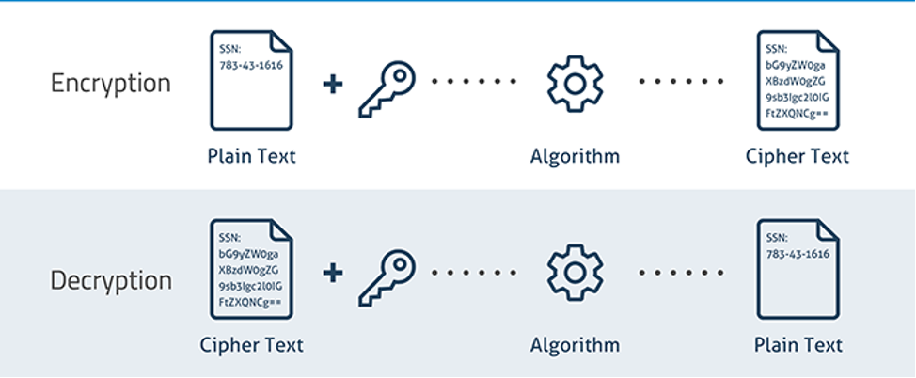

Slide 14

SOME BASIC TERMS IN CYBER SECURITYIDS/IPS
IDS :- Intrusion Detection System
An Intrusion Detection System (IDS) is a network security technology originally built for detecting vulnerability exploits against a target application or computer.
It consist of 2 types:-
NIDS :- Network Intrusion Detection System
HIDS :- Host Intrusion Detection System
IPS :- Intrusion Prevention System
An intrusion prevention system (IPS) is a network security tool (which can be a hardware device or software) that continuously monitors a network for malicious activity and takes action to prevent it, including reporting, blocking, or dropping it, when it does occur.

Slide 15

DOS/DDOS
DDOS:-
A Denial-of-Service (DoS) attack is an attack meant to shut down a machine or network, making it inaccessible to its intended users. DoS attacks accomplish this by flooding the target with traffic, or sending it information that triggers a crash.
DDOS:-
DDoS Attack means "Distributed Denial-of-Service (DDoS) Attack" and it is a cybercrime in which the attacker floods a server with internet traffic to prevent users from accessing connected online services and sites.

Slide 16

MALWARE
Malware is intrusive software that is designed to damage and destroy computers and computer systems. Malware is a contraction for “malicious software.” Examples of common malware includes viruses, worms, Trojan viruses, spyware, adware, and ransomware.
MALWARE PRECAUTIONS :-
Keep your computer and software updated.
Use a non-administrator account whenever possible.
Think twice before clicking links or downloading anything.
Be careful about opening email attachments or images.
Don't trust pop-up windows that ask you to download software.
Limit your file-sharing

Slide 17

WIRELESS ATTACKS
Wireless attacks include of :-
WIFI Hacking - Wifi hacking is essentially cracking the security protocols in a wireless network, granting full access for the hacker to view, store, download, or abuse the wireless network. when someone hacks into a Wifi, they are able to observe all the data that is being sent via the network.
Wifi hacking tools used in Linux(kali):- wifite , reaver , aircrack-ng , fluxion
MITM (man in the middle) - An attack in which an attacker is positioned between two communicating parties in order to intercept and/or alter data traveling between them.
MITM tools used in Linux(kali) :- packet creater , eatercap , Dsniff , Driftnet

Slide 18


